Slide 1
System Call
Presented by:
Aarti Sharma
Roll no: 333

Slide 2
What is System Call?
System call provides an interface to the services made available by an OS
System call are routines written in C and C++ and for low level tasks.
In every second there may be thousand of System calls invoke by OS in response to the operation.
System call differ may in format, functionality ,scope , parameter passed and results

Slide 3
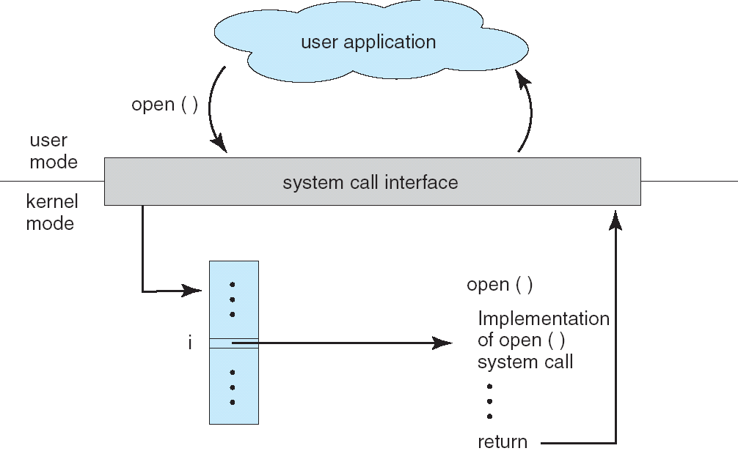
How System Call Implemented?

Slide 4
A specific no is associated with each system call.
These system-call interface maintains a table indexed according to these numbers.
The system l interface then invokes intended system call by using its no OS kernel & returns status of system call and any return values.
The run-time support system provides a system-call interface that serves as link to system calls made available by OS.
The system call interface intercepts function call in API & invokes necessary system call within OS.

Slide 5
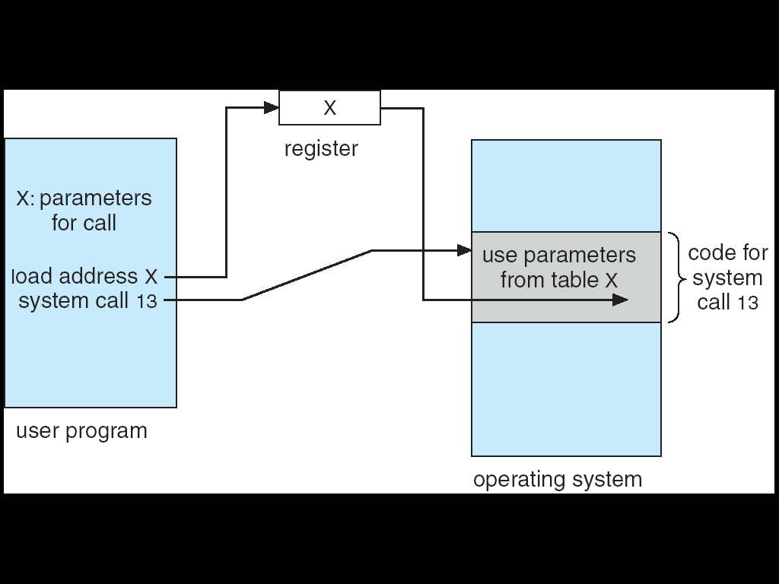
Parameter Passing In System Call

Slide 6
Three general methods are used to pass parameter to OS.
The simplest approach is to pass the parameters in register ,if parameter can be store in the register.
If more parameters then they are stored in block or table in memory and address of block is pass as parameter.
Parameters are also push on stack by program and popped off by OS.

Slide 7
Types of System call
Process control
Device manipulation
Information maintenance
File manipulation
Communication

Slide 8
Process Control
System call related to Process Control
End, abort
Load, execute
Create process, terminate process
Get Process, terminate process
Get process attributes, set process attributes
Wait for time
Allocate and free memory

Slide 9
File management
System call related to File management
Create file, delete file
Open ,close
Read, write, reposition
Get file attributes, set file attributes

Slide 10
Device management
System call related to device management
Read write reposition
Request device, release device
Get device attributes, Set device attributes
Logically attach or detach devices

Slide 11
Information Management
Types of System calls related to Information Management.
Get time or date, set time or date
Get system data, set system data
Get process file or device attributes
Set process file, or device attributes

Slide 12
Communication
System call related to Communication
Create, delete communication connection.
Send, receive messages
Transfer status information
Attach or detach remote devices

Slide 13
Thank You

